Slide 1
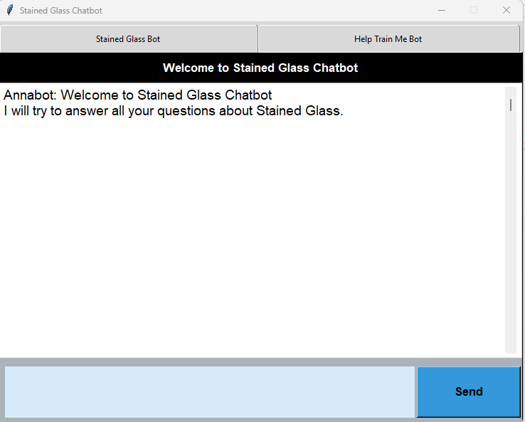

Stained Glass Chatbot
By: Kimberly Cable
Notes:
Hi, my name is Kimberly and today we are going to talk about a Stained Glass Chatbot.

Slide 2

What do I need to start?
Can anyone do it?
Do I need special tools?
Notes:
When you are first learning a hobby, you have a lot of questions.
Some go to classes, some go to books, and some go online to find answers.
The problem arises when a student goes home from a class or reads a book or blog, they still have questions.
This chatbot is aimed to help consolidate a lot of questions the user may have into a learning environment where the chatbot can help answer those questions.

Slide 3
{
"intents": [
{
"tag": "greeting",
"patterns": [
"Hi",
"Hello",
"Hey"
],
"responses": [
"Hello",
"Hi",
"How are you?"
]
},
{
"tag": "goodbye",
"patterns": [
"Bye",
"See you later",
"Goodbye"
],
"responses": [
"See you!",
"Have a nice day!",
"Bye"
]
},
Tag: topics that a user may query about
Intents.json: initial data for the model to learn from
Patterns: queries that a user may ask about a tag
Responses: static responses that will be used for answers to the queries about the tags
Data
Notes:
For the chatbot to learn, initial data needs to be created.
For this chatbot, the data was created from gathering questions people had on social media sites like Facebook, and stained glass websites, and instructional books.
With the data I gathered an intents.json file was created.
The intents.json file is used to initially train the model.
Tags are like topics that a user may have a question about.
Patterns are the questions that a user may ask about that tag or topic.
And Responses are what the chatbot will answer with about the specific tag. There can be multiple responses to the same tag and the chatbot will randomly choose a response.

Slide 4
Training
Intents
{
"tag": "greeting",
"patterns": [
"Hi",
"Hello",
"Hey"
],
"responses": [
"Hello",
"Hi",
"How are you?"
]
},
Words
Classes
[',', '50/50', '60/40', 'a', 'anyone', 'are', 'artistic', 'awesome', 'be', 'beginner', 'best', 'break', 'buy', 'bye', 'can', 'circle', 'cool', 'copper', 'curve', 'cut', 'cutting', 'decorative', 'diamond', 'do', 'doe', 'dot', 'fit', 'fitting', 'flux', 'fluxing', 'foil', 'for', 'get', 'glass', 'go', 'good', 'goodbye', 'grinder', 'have', 'hello', 'here', 'hey', 'hi', 'hole', 'how', 'i', 'in', 'into', 'intricate', 'is', 'jewelry', 'kind', 'later', 'line', 'measurement', 'moon', 'my', "n't", 'name', 'need', 'not', 'of', 'off', 'on', 'paint', 'peal', 'piece', 'place', 'pretty', 'saw', 'score', 'see', 'should', 'size', 'solder', 'soldering', 'splinter', 'stained', 'start', 'sticking', 'supply', 'talent', 'taurus', 'thank', 'thanks', 'the', 'there', 'this', 'to', 'trying', 'use', 'wavy', 'we', 'what', 'whats', 'when', 'where', 'who', 'why', 'window', 'with', 'you']
['breaks', 'circle', 'copperfoil', 'decorative', 'drilling', 'flux', 'foilproblems', 'goodbye', 'greeting', 'grinder', 'measurements', 'moon', 'name', 'occupation', 'paint', 'saw', 'shopping', 'skill', 'solder', 'splinters', 'stainedglass', 'supply', 'thanks']
Model
Notes:
Before we can train this data, we first process the tags and patterns. This involves creating a vocabulary of words from the patterns – which is called tokenizing.
We will also take the tags and create classes. Basically taking all the tags and putting into one list.
Once we have the words and classes, we take our patterns and feed them into our model and output the class respective to those patterns.

Slide 5
Model: "sequential"
_________________________________________________________________
Layer (type) Output Shape Param #
=================================================================
dense (Dense) (None, 128) 12672
dropout (Dropout) (None, 128) 0
dense_1 (Dense) (None, 64) 8256
dropout_1 (Dropout) (None, 64) 0
dense_2 (Dense) (None, 22) 1430
=================================================================
Total params: 22,358
Trainable params: 22,358
Non-trainable params: 0
Analysis
Epoch 195/200
14/14 [==============================] - 0s 769us/step - loss: 0.0563 - accuracy: 0.9857
Epoch 196/200
14/14 [==============================] - 0s 769us/step - loss: 0.0612 - accuracy: 0.9714
Epoch 197/200
14/14 [==============================] - 0s 846us/step - loss: 0.0846 - accuracy: 0.9714
Epoch 198/200
14/14 [==============================] - 0s 769us/step - loss: 0.0692 - accuracy: 0.9857
Epoch 199/200
14/14 [==============================] - 0s 762us/step - loss: 0.0340 - accuracy: 0.9857
Epoch 200/200
14/14 [==============================] - 0s 808us/step - loss: 0.0315 - accuracy: 1.0000
Notes:
The model was built using the Sequential class in Tensorflow’s Keras. It has 3 layers and uses some dropout layers to help with overfitting the data between the layers.
The model trained 22,358 words and after 200 epochs (or full passes over the training data) we got down to a loss value of 0.0315 and 100% accuracy (although this may slightly change each time the model is retrained).
The lower the loss value and closer to 0, the closer the predictions are to the true tags.
The model is then saved for the chatbot to use.

Slide 6
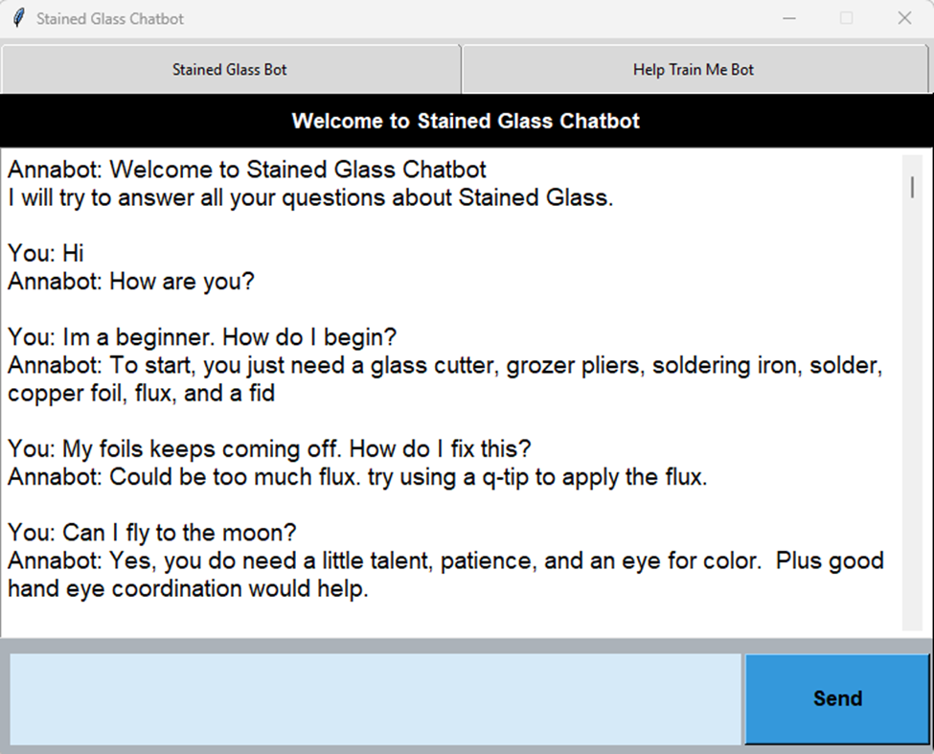
Testing
[('greeting', '0.99946314')]
{
"intents": [
{
"tag": "greeting",
"patterns": [
"Hi",
"Hello",
"Hey"
],
"responses": [
"Hello",
"Hi",
"How are you?"
]
},
Notes:
After the Analysis of the model, we are ready to begin the testing phase.
The testing phase is really the user using the chatbot to ask questions to see if we get the appropriate answers.
Let’s go through the example we have here
The first question is basically “Hi”
The response we got was “How are you” back.
The chatbot correctly found with a probability of 99.9% the tag “greeting”
As you can see in the intents.json file the tag “greeting” had the patterns “hi”, “hello” and “hey”. From this you can see why the chatbot found the correct tag with such a high probability.

Slide 7
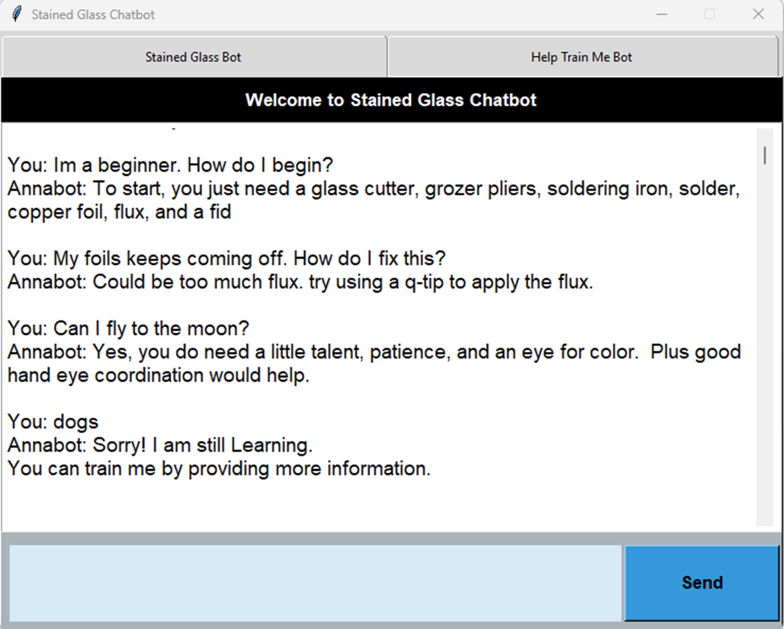
Testing
[('supply', '0.92462075')]
{
"tag": "supply",
"patterns": [
"What supplies do I need?",
"What do I need to start with?",
"supplies",
"What does a beginner need?",
"What should I get?",
"supplies",
"How do I start?"
],
"responses": [
"At Anything Stained glass you can get a starter kit. It has everything you need.",
"To start, you just need a glass cutter, grozer pliers, soldering iron, solder, copper foil, flux, and a fid"
]
},
Notes:
In the next question “Im a beginner, how do I begin”
The chatbot correctly responded with “To start, you just need a glass cutter, grozer pliers, soldering iron, solder, copper foil, flux, and a fid”
It correctly predicted the tag “supply” with a 92.5% probability.

Slide 8
Testing
[('foilproblems', '0.9988248')]
{
"tag": "foilproblems",
"patterns": [
"copper foil",
"copperfoil peels off",
"foil not sticking",
"My foil isn't sticking to the glass",
"copper foil peels off"
],
"responses": [
"Warm the glass on a light box or plate warmer. This should help with sticking",
"Clean glass with warm soapy water and wipe edges with the rubbig alcohol. This removes all unseen oils",
"The age of the foil and oxidation may be causing it. Try a new roll of foil.",
"It could be over burnishing. Try burnishing in one direction and not to rub too many times",
"Could be too much flux. try using a q-tip to apply the flux."
]
},
Notes:
The next question: “My foils keeps coming off. How do I fix this?”
The chatbot correctly responded with “Could be too much flux. try using a q-tip to apply the flux.”
It correctly predicted the tag “foilproblems” with a 99.8% probability

Slide 9
Testing
[('skill', '0.92427206')]
{
"tag": "skill",
"patterns": [
"Do I need talent?",
"Can anyone do this?",
"Should I be artistic?",
"artistic"
],
"responses": [
"Yes, you do need a little talent, patience, and an eye for color. Plus good hand eye coordination would help."
]
}
Notes:
In this next question “Can I fly to the moon?”
The chatbot incorrectly predicted the tag “skill” with a 92.4% probability.
Here the user could go into the training bot tab a help retrain the chatbot about flying to the moon.

Slide 10
Testing
Notes:
Lastly in the statement dogs. The chatbot correctly couldn’t predict with a probability over 50% the correct response so it answer with the default response of “Sorry, I am still learning. You can train me by providing more information”
This will allow the user to either rephase their question or go to the training bot tab to train the chatbot further about dogs (if this was a real stained glass question)

Slide 11
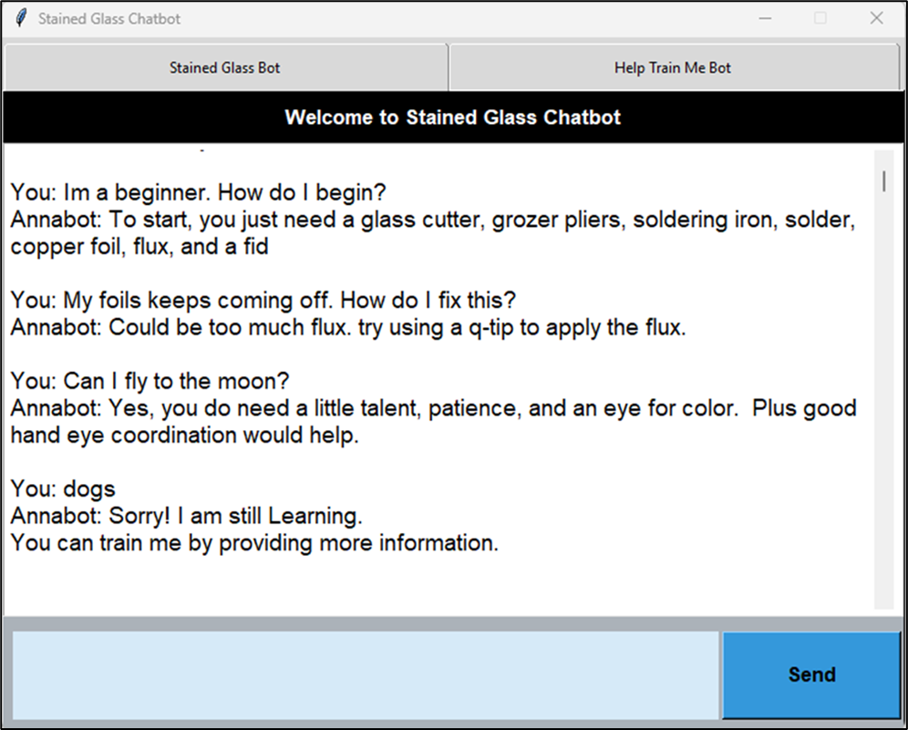
Conclusion
Notes:
Although this is a very primitive version of what a chatbot should be, it answers questions to the best of its ability (as any normal human would).
As users input more of their expertise into the training tab, the model will be able to have a broader and more decisive model to draw from so as time goes on the chatbot will be a good tool for any beginning-stained glass artist.

